Slide 1
UltraLite Coding
Nicholas Walter
Max Maier
Tyler Hogenson
Ben Finnerty
Spencer Lofing

Slide 2
How did we work?
We had regular weekly meetings.
Usually on Sundays.
We communicated consistently, mostly via text.
We broke up work to be done as Issues on GitHub.

Slide 3
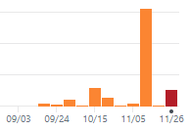
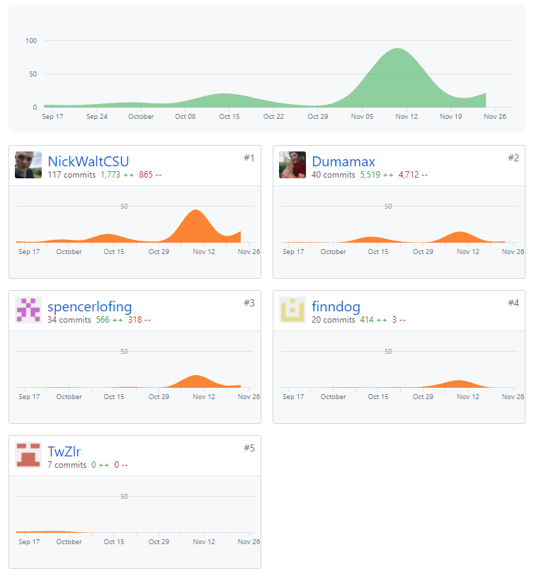
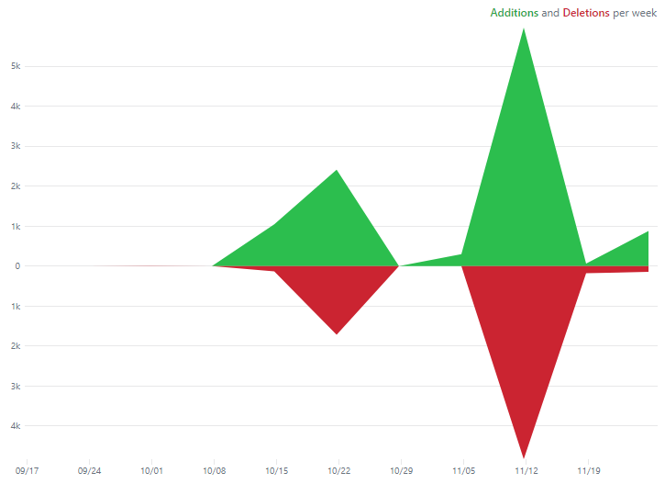
More Information

Slide 4
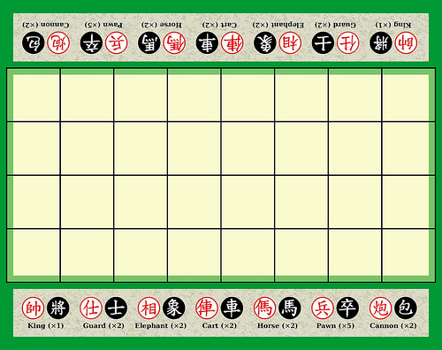
Banqi
Description of Banqi
Half/Blind Chinese Chess – game consists of tokens with various power levels, each placed face-down on the board in a random position. Tokens must be flipped face up (revealing color/power level) before you can move them – higher power level tokens can take lower power level tokens. Soldier can take General, General cannot take Soldier, Cannon can take anything (by jumping).

Slide 5
Code Improvements (Issues Closed)
#72 – Speed up Queries (Spencer)
#75 – Implement Forfeit Game, UI Side (Tyler)
#76 – Improvements to Active Games (Nicholas)
#77 – Add a Refresh to the Board (Tyler)
#82 – Hash Passwords (Spencer)
#83 – Fix Package Extensions (Max)
#86 – Fix Deregister (Spencer)
#88 – Show Color of User on Board (Tyler)
#91 – Implement Forfeit Game, Database Side (Spencer)
#93 – Implement Creator Color (Nicholas)
#95 – Fix Graveyard Issue (Nicholas, Max)

Slide 6
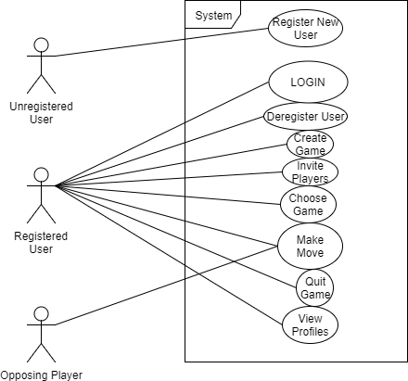
Use Case Document

Slide 7
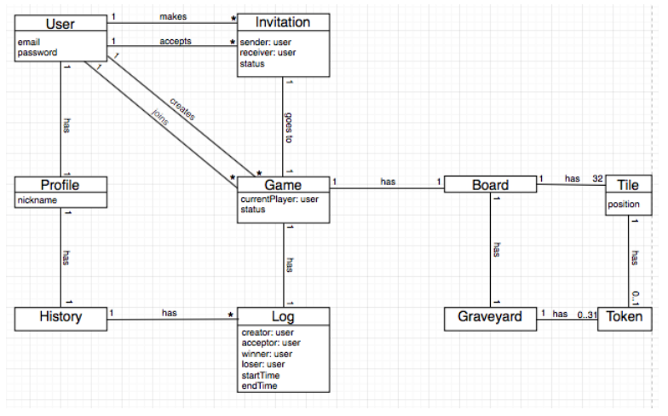
Domain Model Document

Slide 8
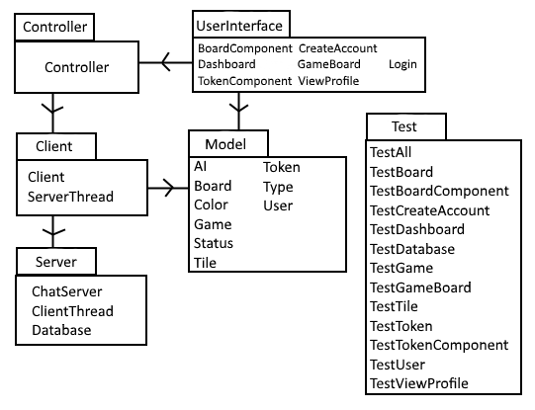
Design Document, Part 1, Package Diagram

Slide 9
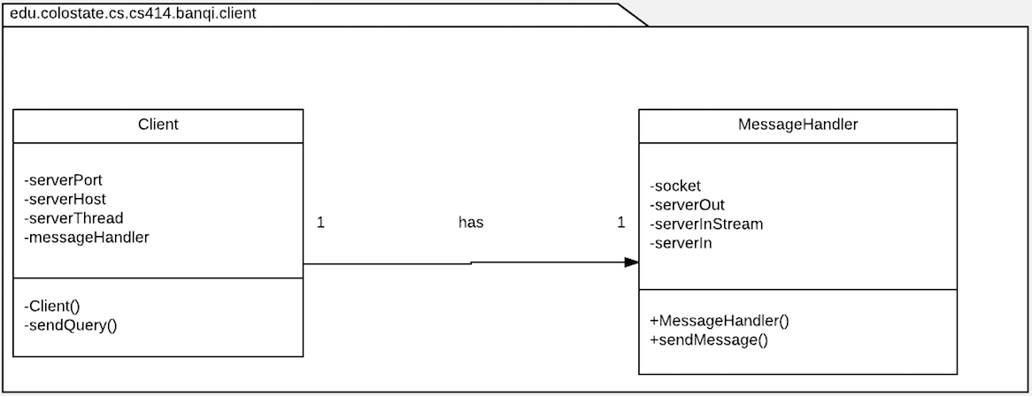
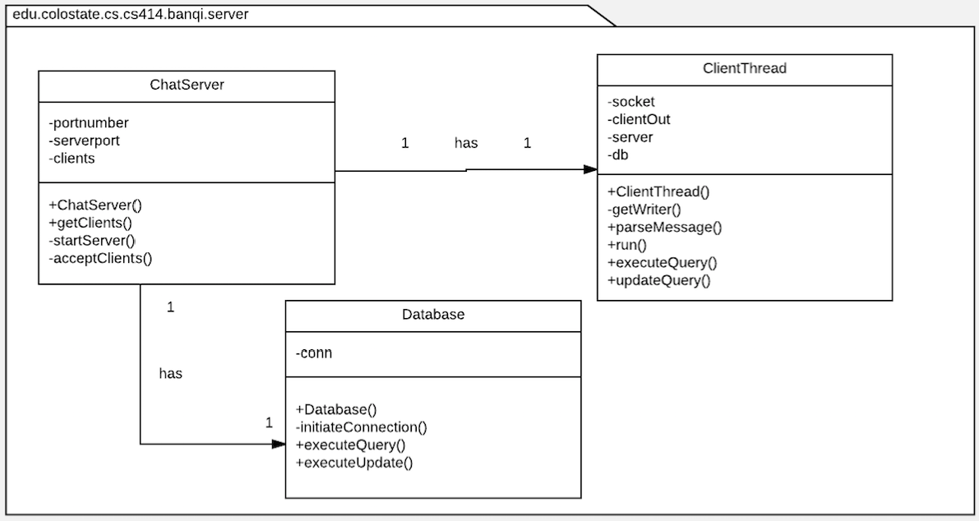
Design Document, Part 2, Design Class Diagram

Slide 10
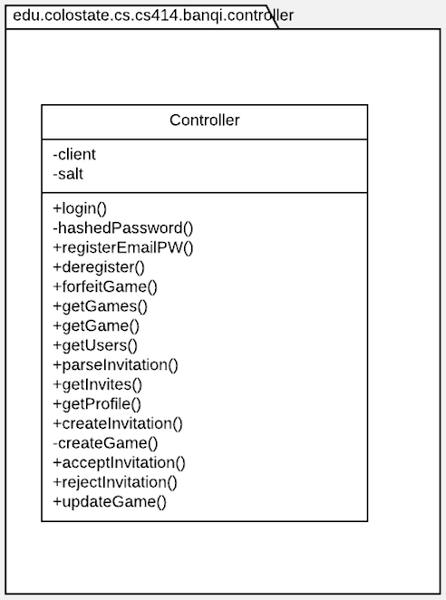
Design Document, Part 2, Design Class Diagram

Slide 11
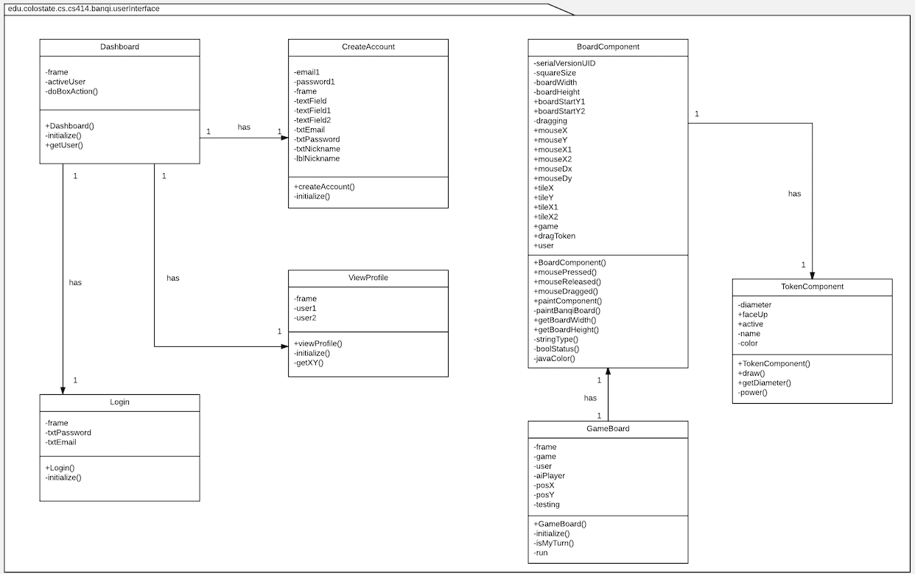
Design Document, Part 2, Design Class Diagram

Slide 12
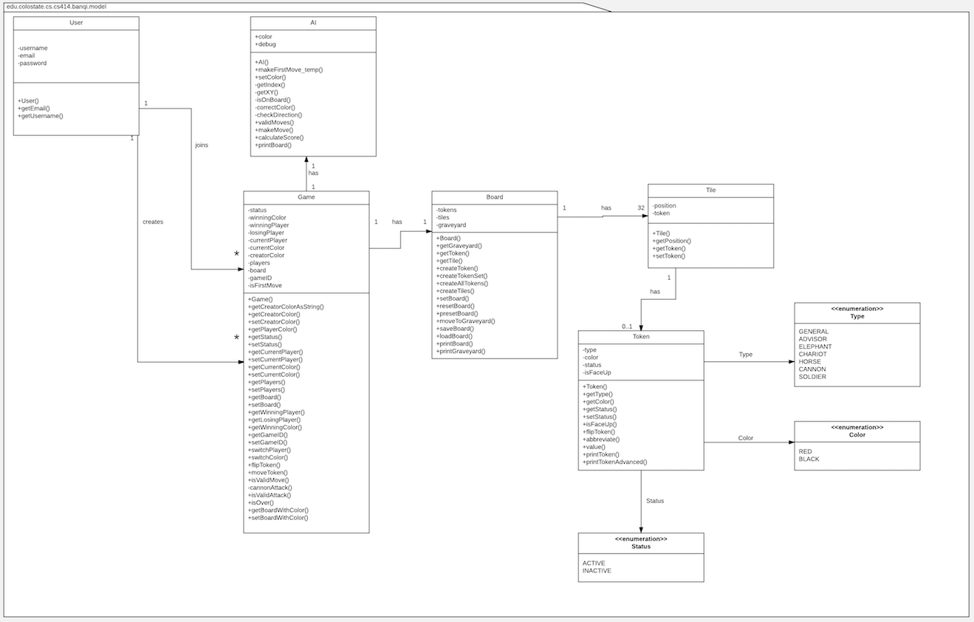
Design Document, Part 2, Design Class Diagram

Slide 13
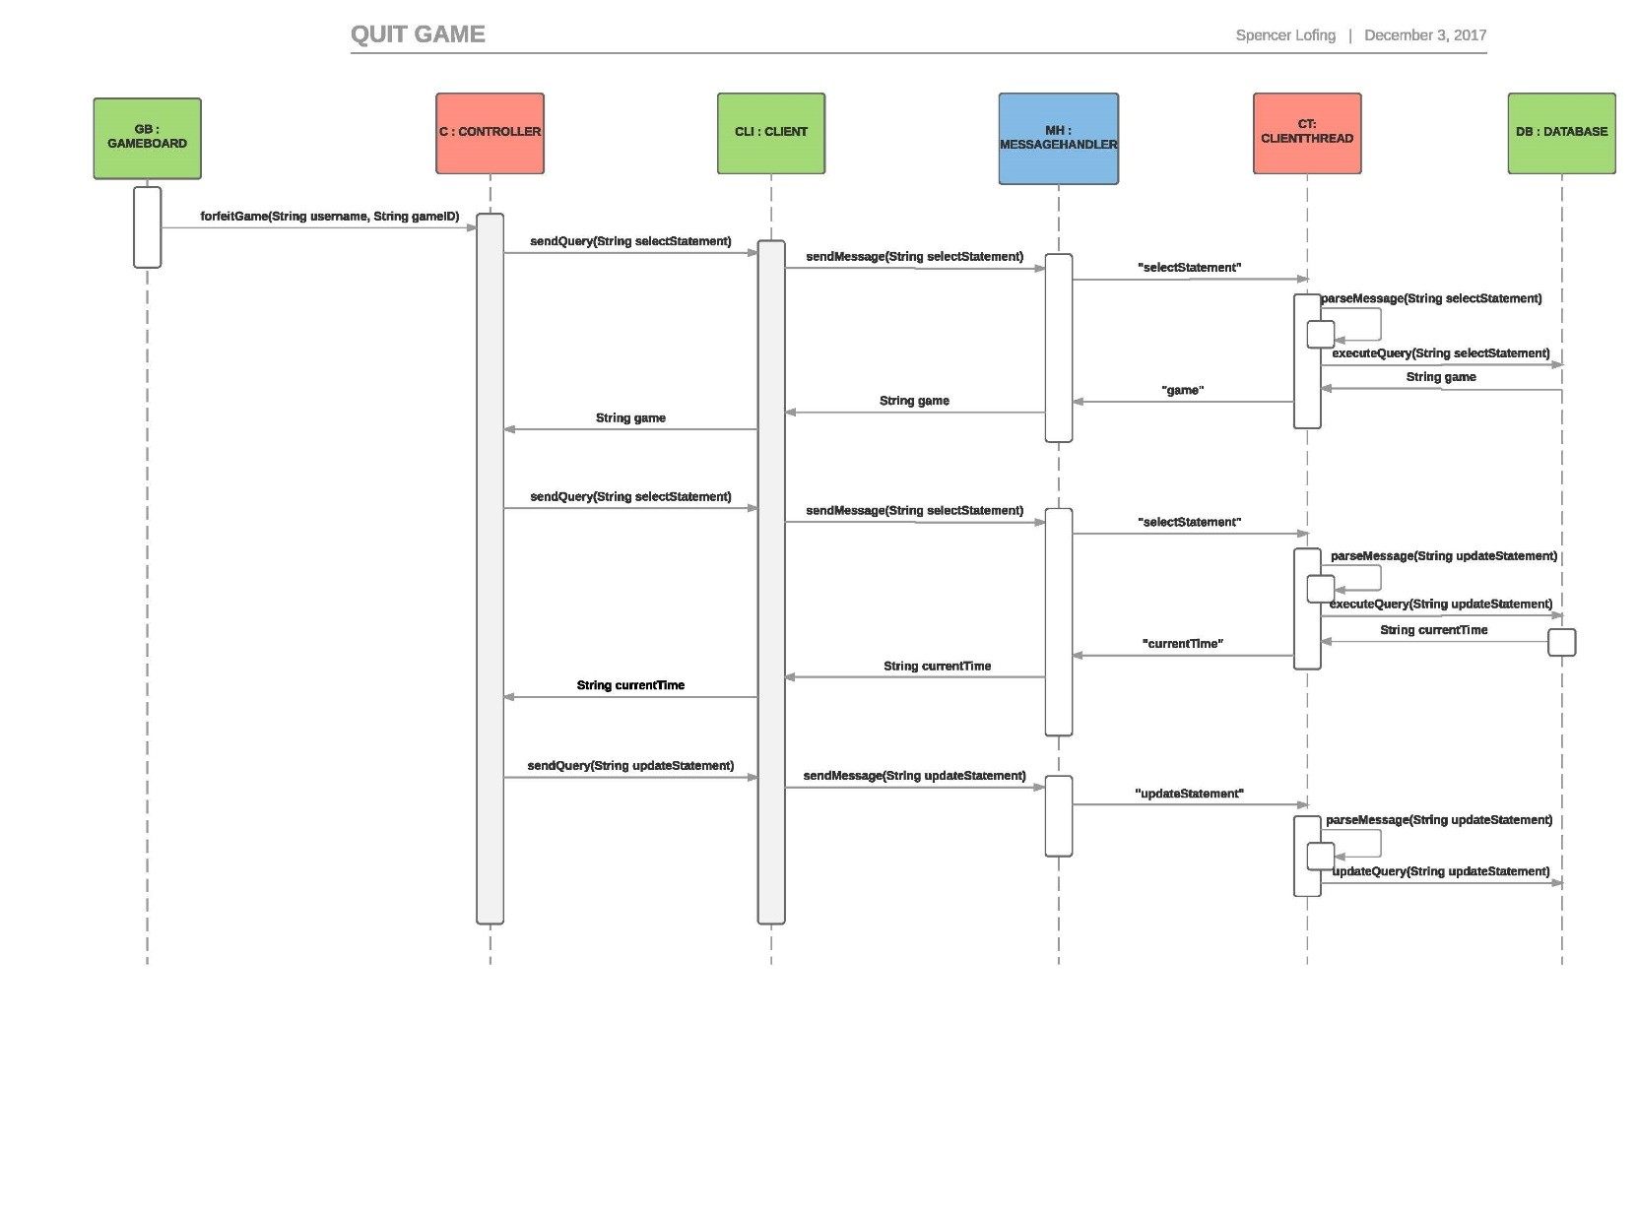
Design Document, Part 3, Sequence Diagram 1

Slide 14
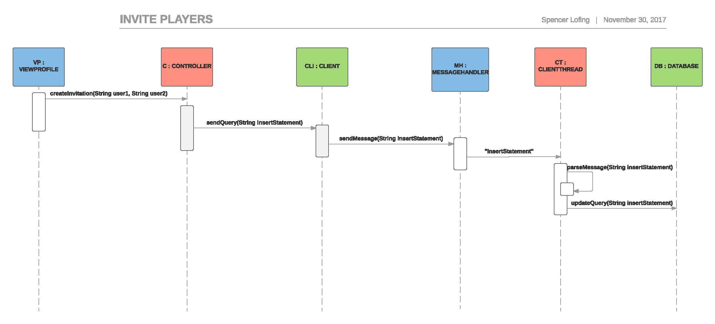
Design Document, Part 3, Sequence Diagram 2

Slide 15
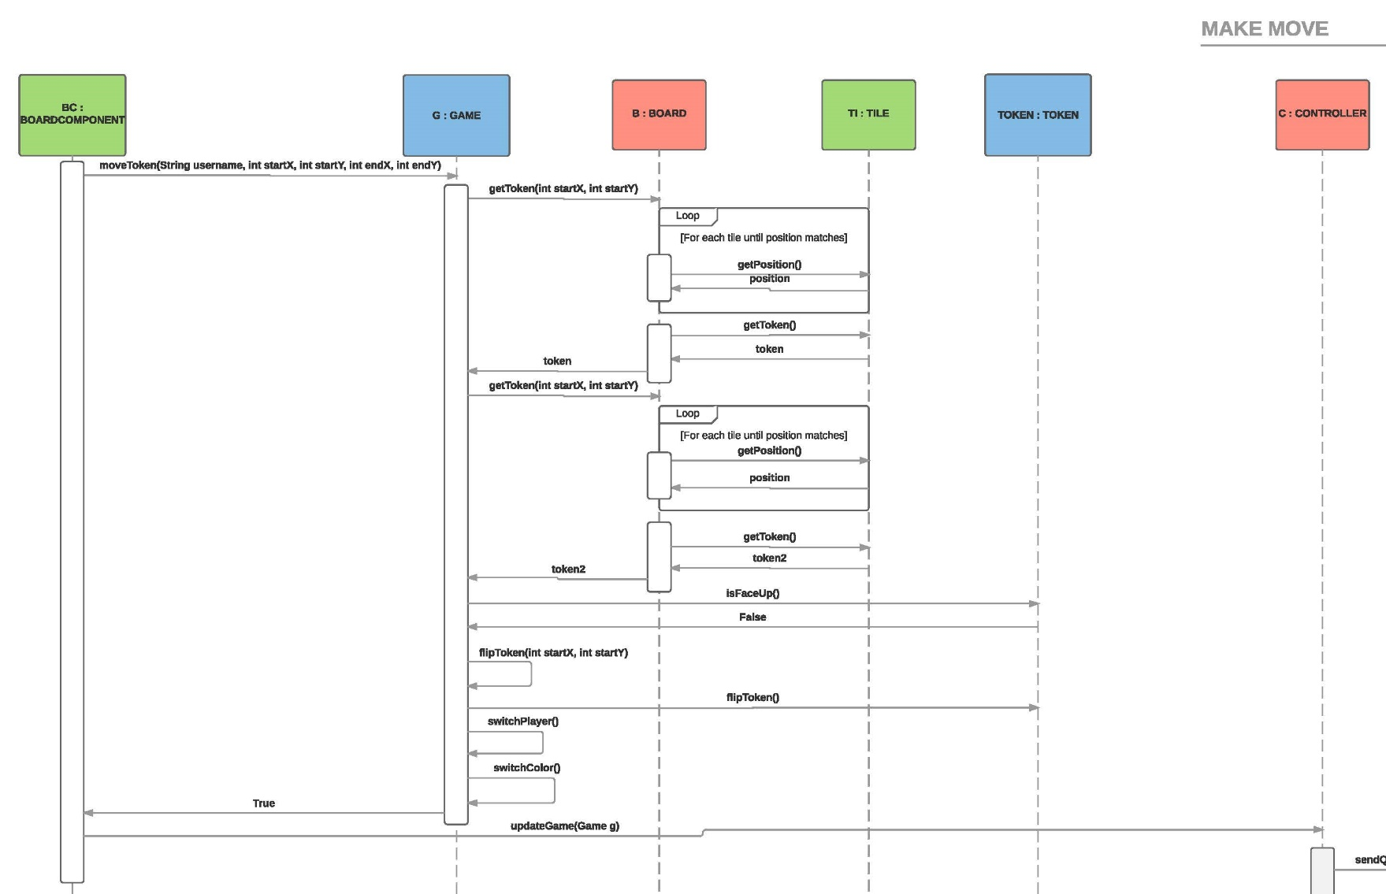
Design Document, Part 3, Sequence Diagram 3.1

Slide 16
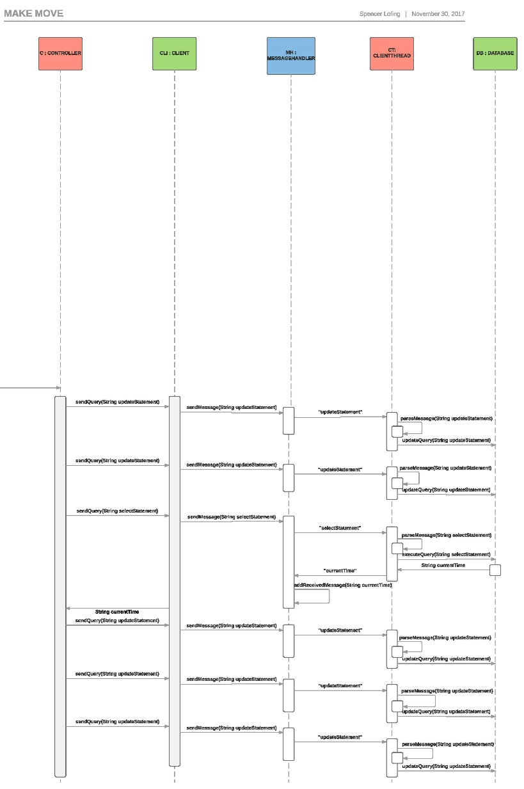
Design Document, Part 3, Sequence Diagram 3.2

Slide 17
Testing Document

Slide 18
Development Manual
Development Manual
Tools needed to begin development of product:
Eclipse (https://www.eclipse.org/downloads/)
MySQL (https://dev.mysql.com/downloads/repo/)
Git (https://git-scm.com/downloads)
Steps to set up MySQL:
Start MySQL server on a local machine
Download mysql-connector-java-5.1.44-bin.jar into local project
Steps to be taken to work on Project in Eclipse:
Attain git tools in eclipse by clicking on Window, Show View, Other, Git, Git Repositories & Git Staging
Clone Github repository by clicking on “Clone a Git Repository and add the clone to this view” button in Eclipse
Then, a new window will appear and click on “Clone URI”
Go to https://github.com/NickWaltCSU/cs414-f17-301-UltraLiteCoding, and click on “Clone or Download”
Copy the URL that appears and copy it into the URI text box that appears when Step 3 is performed.
To get the latest version of the project, right click on the repository, go to “Team”, “Switch”, “master”
Right click on the repository again, go to “Team”, “Fetch from Upstream”, then “Pull”
Start making updates or changes to the project by making a new local branch.
Right click on the repository and select “Team”, “Switch To”, “New Branch”
Any changes made will appear in Git Staging area in the unstaged commits text box
To submit these changes to the Github repository, drag changed files to the staged commits text box and click on Commit and Push

Slide 19
Development Manual
Steps to be taken to run Banqi:
Run the server so users can play other users on different machines and can retrieve information from the database
Run Login, and a window will appear with email and password text boxes.
If you already have created account, enter your email and password and click “Login”
If you have not created an account, click “Create Account” and enter credentials
Once logged in, another dashboard window will appear where you can pick another user to send an invite to.
You can also select a user and click view profile to see a history of games and win percentage
If you are sent an invitation, you can either accept or reject the invitation
If you accept the invitation, a game board will appear and a new game is started

Slide 20
Refactoring and Design Pattern List
Separated classes into MVC layout
Model contains all game logic
View contain UI elements
Controller helps with server and database interaction
Implemented Façade Pattern
Mainly within Model package
Extraction of Code
Rearranged class structure to reduce coupling
Removed unneeded/unused classes
Log, Profile, Invitation

Slide 21
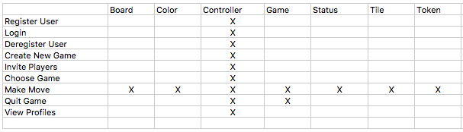
Traceability Link Matrix

Slide 22
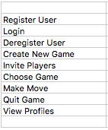
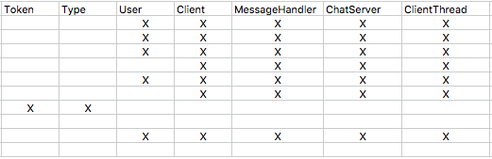
Traceability Link Matrix

Slide 23
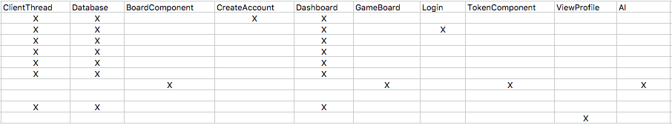
Traceability Link Matrix

Slide 24
Challenges and Lessons Learned
Teamwork:
Challenge: we struggled to follow through on our plans.
Lesson: make more manageable plans.
Communication:
Challenge: we struggled to communicate our difficulties.
Lesson: communicate our difficulties.
Software Design:
Challenge: we struggled to do TDD or use Agile Methodology.
Lesson: making more time for work allows us to work how we want to.
Software Development:
Challenge: we struggled to implement as many design patterns as we would’ve liked.
Lesson: making more time for work allows us to implement what we want to.
Commit Log:
Challenge: 156 commits the week of November 12th.
Lesson: ensure all group members are doing their parts before the weekend before the due date.

Slide 25
Demo

